Slide 1
Class
0f
2025
Welcome Parents

Slide 2
Presentation Goals:
ALPHA COUNSELOR
A-CHI Ann Eaglin
CHO - HAM Stacy Jones
HAN - LON Leigh Ann Field
LOP - PAP Delinda Dudley
PAR - SM Sarah Sumpter
SN - Z Linda Taylor
ESL/ Yahaira Rodriguez
Newcomer
LEAD COUNSELOR Tracy Eubanks
Counselor Introduction
PWSH Counseling Vision/Mission/Commitment
Social Worker & Hope Squad
Junior Year Timeline
Upcoming Events
SchooLinks
Resources
Plano West
DYNAMIC Counseling Department

Slide 3
PWSH Counseling Vision/ Mission
Vision Statement:
Plano West Counselors empower and prepare students to become resilient individuals who contribute to a diverse and dynamic world.
Mission Statement:
The Plano West Counseling Department is a visible and valuable resource which serves to advocate, support and develop student-centered programs that provide social/emotional development, college, career and military readiness and academic success for all students.

Slide 4
When should I apply for FAFSA for 2025-2026?
The U.S. Department of Education announced that the 2025-26 FAFSA will be available for students and families by December 1, 2024. The preferred FAFSA deadline for the 2025-26 school year is March 15, 2025.
FAFSA 2025-2026: What You NEED to Know Now! 🚨💸

Slide 5
Pathways after High School
College
Military
Career

Slide 6
(CCMR) is about preparing
students for life after graduation.
How do I earn CCMR in Texas?
Students can earn CCMR accreditation through their performance on:
College entrance exams such as the SAT, ACT, and TSIA (Texas Success Initiative Assessment).
Taking an AP class and scoring a 3 or better.
Dual Credit (earning 6 hours)
College Prep Class - Online class for math and English
Military enlistment (ie. national guard, army, marines, navy)
Certification completion (Vet. Tech, CNA, Microsoft Office)

Slide 7
Apply to colleges & universities
Applications
Essays
Extracurricular Activities
Resume
University Specific
Use the university application

Slide 8
Getting Accepted into College
GPA
Course Rigor
SAT & ACT
Scores
4.0 weighted
Essays
Extracurricular
Activities
Recommendation
Letters

Slide 9
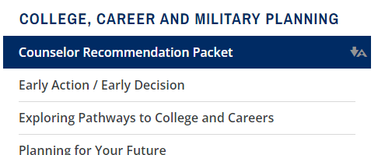
Students needing a recommendation from a counselor will need to submit a counselor packet. Packets can be found on the Plano West Website, under counseling.
Packets can be submitted in
person or emailed directly to
your counselor.

Slide 10
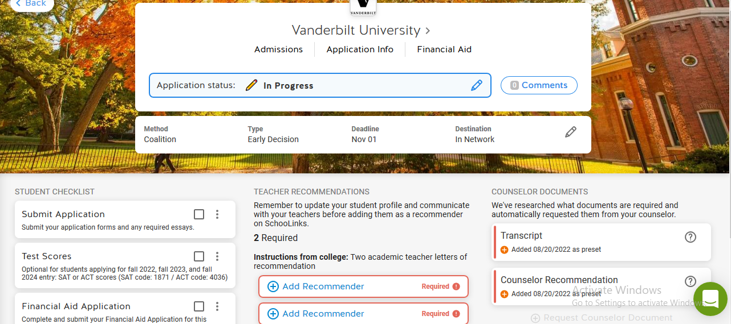
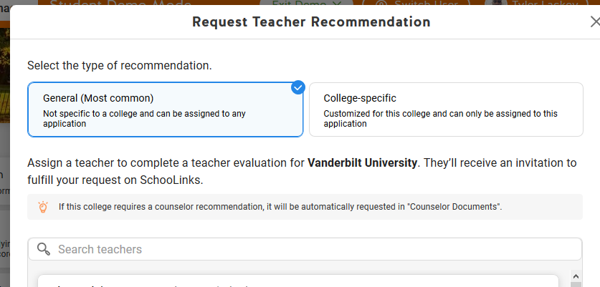
Request
Teacher
Recommendation
The teacher is alerted via email of the request.
Complete the Counselor Recommendation Packet
http://www.pisd.edu/domain/2498
Select your teacher….
Do not select your counselor to write a teacher rec letter

Slide 11
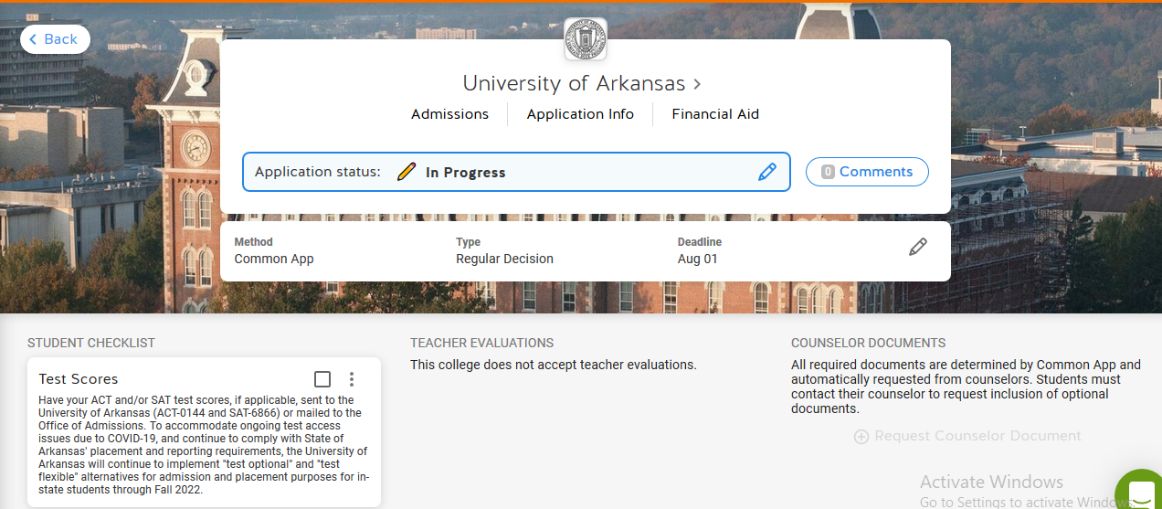
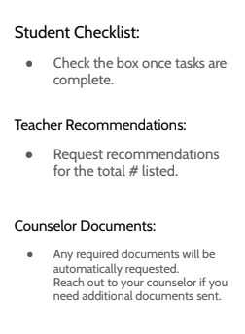

Slide 12
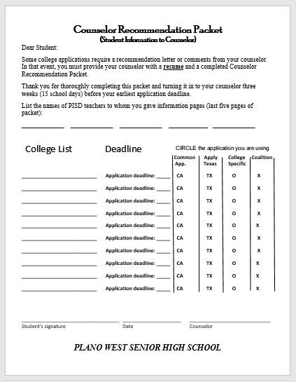
Counselor
Recommendation
If required by college
Give completed packet to your counselor 15 school days before
your earliest deadline
https://www.pisd.edu/domain/2498

Slide 13
Finalize

Slide 14
Test Scores
Students must request their ACT/ SAT score(s) from the testing agency
Test score(s) must be sent directly to the college, university, or NCAA directly from the testing agency

Slide 15
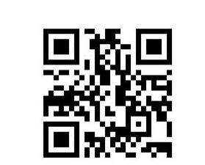
Plano West Counseling webpage
https://www.pisd.edu/Page/6304
College
&
Career
Readiness Platform
resources College, Career & Military Planning SchooLinks

Slide 16
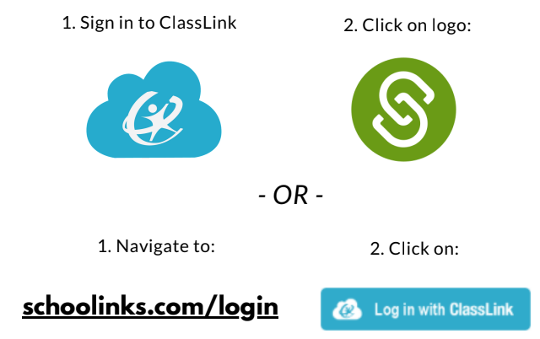
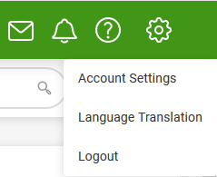
How to log in
+ add the SchooLinks app to your chrome book

Slide 17
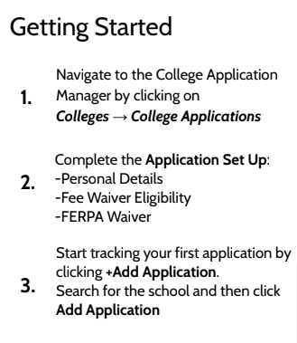
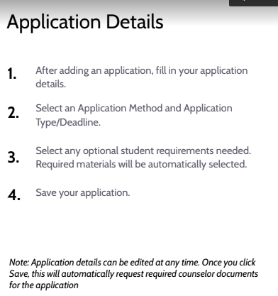
overview
X
Counselor Documents: Transcript,
Secondary School Report, School Profile

Slide 18
Transcripts
College Search
Career Exploration

Slide 19
Transcripts
in
SchooLinks
Official for
NCAA & Scholarships
unofficial/copy

Slide 20
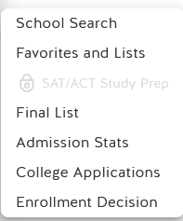
College search

Slide 21
College search

Slide 23
Plano ISD College Night
Sept. 16, 2024 @ 6:00pm
Plano Events Center
Over 200 colleges and universities
Programs
FAFSA/TASFA & Scholarship Informational

Slide 24
Upcoming Senior Webinar
Senior Webinar - Tuesday, Sept. 10th @ 6:30 pm
“A Senior’s Roadmap to the Year Ahead”
Overwhelmed by the seemingly countless essays and applications? Unsure how to stand out and unclear on the timelines for financial aid, scholarships, and interviews? Ensure that you are on track for one of the most important years of your life.

Slide 25
Where to locate resources
Resources
College, Career & Military Planning
SchooLinks
Plano
West
Senior High School
Plano West Counseling webpage
https://www.pisd.edu/Page/6304
https://www.pisd.edu/pwsh

Slide 26
Graduation is the Goal CLASS OF 2025
Wolf Pack

